Slide 1
Golang Demo

Slide 2
Topics:
Array, Slices and Maps
Struct and Interface
Pointers and Errors

Slide 3
Arrays:
● An array is a fixed-size collection of values of the same data type.
● Arrays are declared using the syntax [size]type, where size is the number of elements in the array and type is the
data type of the elements.
● Arrays are indexed starting from 0.
● Arrays can be initialized with a list of values, or their elements can be set individually.

Slide 4
How to access and create array :
Access array elements:
Var array_name[length]Type
Var array_name[index] = element
Create an array:
array_name:= [length]Type{item1, item2, item3,...itemN}
var arrayName[length] datatype
var arrayName = [length] datatype{ values }

Slide 5
Slices:
A slice is a dynamic collection of values of the same data type.
Slices are declared using the syntax []type.
Slices are built on top of arrays and can be resized dynamically.
Slices are indexed starting from 0 and can be sliced using the syntax slice[start:end].
Slices are created using the built-in make function.
Length: The length is the total number of elements present in the array.
Capacity: The capacity represents the maximum size upto which it can expand.

Slide 6
Declaration of slice:
A slice can be declared in any of the following three methods
1. Using the []datatype { values } syntax.
sliceName := []datatype { value1, value2, value3,...valueN }
2. From an Array.
myslice := myarray[start : end]
3. Using the make() function.
mySlice := make ([]type , length [,capacity])

Slide 7
Map:
● A map is an unordered collection of key-value pairs of the same data type.
● Maps are declared using the syntax map[keyType]valueType.
● Maps are initialized using the built-in make function.
● Maps can be accessed using the syntax map[key].
● Maps can be iterated using the range keyword.

Slide 8
Accessing Maps:
// Using var keyword
var mymap = map[TypeOfKey] TypeOfValue { key1:value1, key2:value2,...}
// shorthand syntax
mymap := map[TypeOfKey] TypeOfValue { key1:value1, key2:value2,...}

Slide 9
Structs in Go
● A struct is a sequence of named elements, called fields. Each of them has a name and a type.
● in GO we have structs which hold complex data structures.
● A structs is nothing more that a schema containing a blueprint of data a structure will hold. This blueprint is fixed at compile time.
●It’s not allowed to change the name or the type of the fields at runtime. You can’t add or remove fields from a struct at runtime.

Slide 10
Syntax for a struct
type person struct {
firstName string
lastName string
age int
}
x := person{age: 30, firstName: "John", lastName: "Anderson", }

Slide 11
Go Interface
●The key principle of an interface in Go is to provide method signatures for similar types of objects. Go does not have classes and inheritance to implement object orientation. Go has the interface, an abstract type to fulfill this purpose.
●Interfaces provide behavior to an object: if something can do this, then it can be used here.
● An interface defines a set of abstract methods and does not contain any variable.

Slide 12
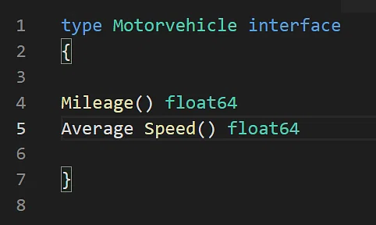
Interface
.

Slide 13
Pointers
What is Pointers:-
→ Pointers in Go programming language or Golang is a variable that is used to store the memory address of another variable.
→ A pointer is a special kind of variable that is not only used to store the memory addresses of other variables but also points where the memory is located and provides ways to find out the value stored at that memory location.
→ It is generally termed as a Special kind of Variable because it is almost declared as a variable but with *(dereferencing operator).

Slide 14
Declaration and Initialization of Pointers
Before we start there are two important operators which we will use in pointers i.e.
* Operator also termed as the dereferencing operator used to declare pointer variable and access the value stored in the address.
& operator termed as address operator used to returns the address of a variable or to access the address of a variable to a pointer.

Slide 15
Let’s See the coding Approach
package main
import “fmt”
func main() {
//var x int = 5748
// declaration of pointer
var p *int
//initialization of pointer
p = &x

Slide 16
Output of code:-
// displaying the result
fmt.Println("Value stored in x = ", x)
fmt.Println("Address of x = ", &x)
fmt.Println("Value stored in variable p = ", p)
}Output
Value stored in x = 5748
Address of x = 0x414020
Value stored in variable p = 0x414020

Slide 17
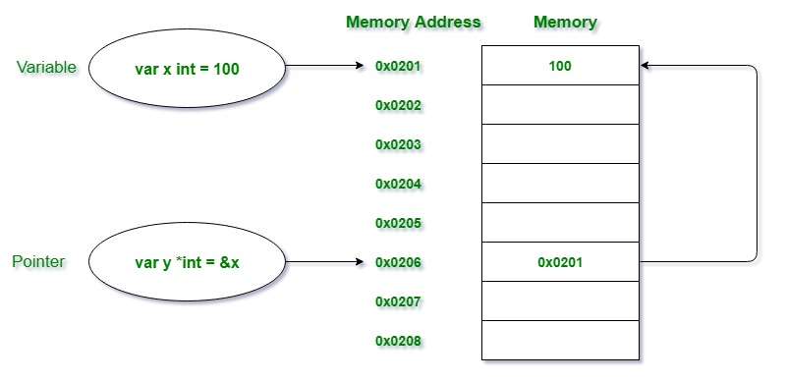
Lets See With Diagrammatic Approach

Slide 18
Important Points Remember About Pointers
1. The default value or zero-value of a pointer is always nil. Or you can say that an uninitialized pointer will always have a nil value.
2. Declaration and initialization of the pointers can be done into a single line.
Example:
var s *int = &a
3. If you are specifying the data type along with the pointer declaration then the pointer will be able to handle the memory address of that specified data type variable.

Slide 19
Important Points Remember About Pointers
4. To overcome the above mentioned problem you can use the Type Inference concept of the var keyword. There is no need to specify the data type during the declaration. The type of a pointer variable can also be determined by the compiler like a normal variable
// using var keyword we are not defining any type with variable
var y = 458

Slide 20
Errors
What is an Error:-
Error is an illegal operation performed by the user which results in abnormal working of the program. Programming errors often remain undetected until the program is compiled or executed.

Slide 21
Creating custom errors
The errors.New() method can be used to create new errors and takes the error message as its only parameter.
fmt.Errorf on the other hand also provides the ability to add formatting to your error message.

Slide 22
Error handling in function
Error handling in Golang is done through the built-in interface type, error . It's zero value is nil ; so, if it returns nil , that means that there were no errors in the program.
type error interface {
Error() string
}
type DivZero struct{}
func (myerr *DivZero) Error() string{
return "Cannot divide by 0!"
}

Slide 23
Defer,Panic and recover
defer in Go
We use the defer statement to prevent the execution of a function until all other functions execute.
Golang panic
We use the panic statement to immediately end the execution of the program. If our program reaches a point where it cannot be recovered due to some major errors, it's best to use panic.

Slide 24
Recover in Go
The panic statement immediately terminates the program. However, sometimes it might be important for a program to complete its execution and get some required results.
In such cases, we use the recover statement to handle panic in Go. The recover statement prevents the termination of the program and recovers the program from panic.

Slide 25
package main
import "fmt"
// recover function to handle panic
func handlePanic() {
// detect if panic occurs or not
a := recover()
if a != nil {
fmt.Println("RECOVER", a)
}
}

Slide 26
func division(num1, num2 int) {
// execute the handlePanic even after panic occurs
defer handlePanic()
// if num2 is 0, program is terminated due to panic
if num2 == 0 {
panic("Cannot divide a number by zero")
} else {
result := num1 / num2
fmt.Println("Result: ", result)
}
}

Slide 27
func main() {
division(4, 2)
division(8, 0)
division(2, 8)
}
Output
Result: 2
RECOVER Cannot divide a number by zero
Result: 0

Slide 28
Thank You

